Slide 1


Customer Shopping Behavior Analysis
Uncovering insights from 3,900 purchases to guide strategic business decisions through data-driven analysis of spending patterns, customer segments, and product preferences.

Slide 2
The Foundation: Our Data
DATASET OVERVIEW
3,900
Total Purchases
Transactions analyzed
18
Data Points
Features per customer
50
Locations
Geographic coverage
Key Features Captured
Customer demographics: Age, Gender, Location, Subscription Status Purchase details: Item, Category, Amount, Season, Size, Color
Shopping behavior: Discounts, Promo Codes, Previous Purchases, Review Ratings

Slide 3

Data Preparation in Python
01 02
Data Loading C Exploration
Imported dataset using pandas, checked structure with df.info() and summary statistics
Missing Data Handling
Imputed 37 missing Review Rating values using median rating per product category
03
04
Feature Engineering
Created age_group bins and purchase_frequency_days columns for deeper analysis
Database Integration
Connected to PostgreSQL and loaded cleaned data for SQL analysis

Slide 4
Gender C Spending Patterns
REVENUE INSIGHTS
$180,000.00
Male Customers Drive Revenue
Male customers generated $157,890 in total revenue compared to $75,191 from female customers4more than double the contribution.
$120,000.00
$60,000.00
This significant gap suggests opportunities for targeted marketing campaigns to better engage female shoppers and balance revenue streams.
$0.00
Male
Female

Slide 5





Product Performance C Customer Preferences
Top 5 Products by Rating
77% 77% 76%
Gloves
3.86 average rating
Sandals
3.84 average rating
Boots
3.82 average rating
76%
76%
Hat
3.80 average rating
Skirt
3.78 average rating

Slide 6

shipping insights
Express Shipping
$60.48 average purchase
Premium customers willing to pay more for faster delivery
Standard Shipping
$58.46 average purchase
Slight difference suggests shipping speed isn't a major purchase driver

Slide 7
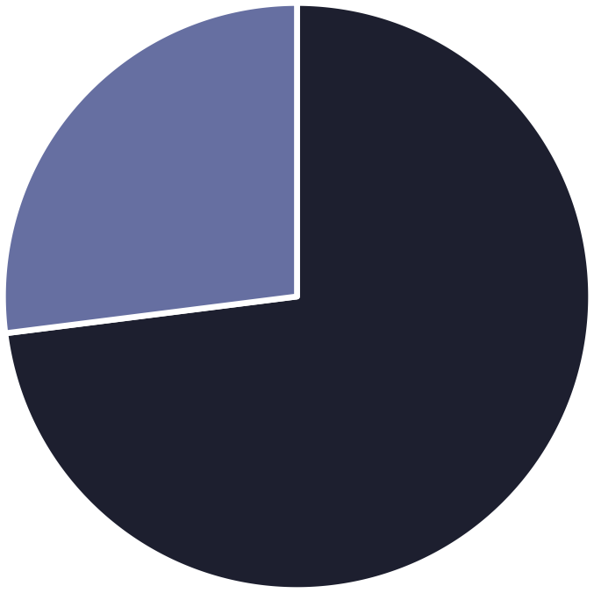


Subscription Status Analysis
Subscription Opportunity
Only 27% of customers are subscribers, yet they contribute $62,645 in revenue with a $59.49 average spend.
Non-subscribers represent 73% of the customer base with $170,436 total revenue and $59.87 average spend4 nearly identical spending patterns suggest untapped subscription potential.
Non-Subscribers
Subscribers

Slide 8



Customer Loyalty Breakdown
SEGMENTATION
Loyal Customers
3,116 customers (80%)
Strong repeat purchase behavior
Returning Buyers
701 customers (18%) Engaged but not yet loyal
New Customers
83 customers (2%)
Fresh acquisition opportunity

Slide 9
Revenue Distribution by Age C Category
Young Adult
Balanced Age Distribution
Revenue is relatively balanced across age groups, with Young Adults leading at
$62,143.
Middle-aged
Adult
Clothing dominates category revenue (~$250K), followed by Accessories (~$200K), Footwear (~$100K), and Outerwear (~$50K).
Senior
$0.00
$25,000.00
$50,000.00
$75,000.00

Slide 10
Business Recommendations
STRATEGIC ACTIONS
Boost Subscriptions
Promote exclusive benefits to convert the 73% non-subscriber base with similar spending patterns
Customer Loyalty Programs
Reward repeat buyers to move the 18% returning segment into the loyal category
Review Discount Policy
Balance sales boosts with margin control4 some products show 50% discount rates
Product Positioning
Highlight top-rated items like Gloves and Sandals in marketing campaigns
Targeted Marketing
Focus on high-revenue segments: Young Adults, Clothing category, and express-shipping users

